Slide 1


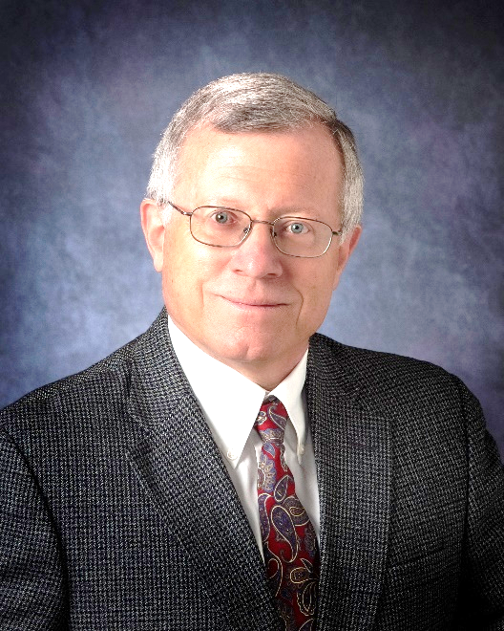
Call for Student Applicants!
Dr. Friedrich Straub Memorial Scholarship
Deadline is October 23th, 2026!
Merit-based competitive scholarship for Undergraduate (Junior/Senior) and Graduate students who demonstrate an interest in pursuing engineering careers in the fixed wing, rotorcraft, or VTOL aircraft industry.
Winning recipient will receive:
  $1,500 to $3,000 depending upon candidate qualifications
  1-year paid membership to the Vertical Flight Society (VFS)
Applicant must be a Full-Time student attending an accredited engineering school in Arizona for the full academic year.
  Accepting Engineering majors and Professional Aviation majors
Contact scholarships@vfsaz.org for more information.
Download application at http://vfsaz.org/scholarships/.

