Slide 1
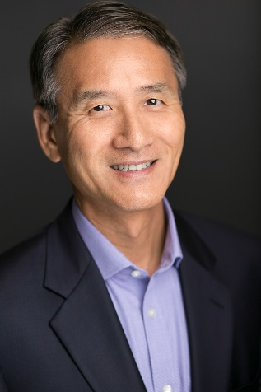
Vertical Flight Society
September 2018 Dinner Meeting
GUEST SPEAKER:
Date:
Wednesday, September 26, 2018
Program:
5:00 – 6:00 PM Professional Networking &
Appetizers (cash bar)
6:00 – 7:00 PM Dinner
7:00 – 8:00 PM Presentation
Location:
Red Mountain Ranch Country Club
6425 E. Teton
Mesa, AZ 85215
(202 Red Mountain & Recker)
Dinner :
Italian Dinner Buffet:
Fettuccini Alfredo,
Chicken Parmesan,
Caesar Salad and Breadsticks
Coffee and Tea
Rey Chu
Manufacturing Technologies
“Additive Manufacturing Strategy
and Digital Transformation”
Cost:
$35 Pre-Pay (before September 20th)
$40 after Sept 20th or at Door $15 Students
Payment via PayPal or credit card at
http://vfsaz.org/activities/
or bring cash/checks to the door No refunds
Please RSVP by Sept 20th to RSVP@vfsaz.org
*VFS Federal ID: #131953506, Non-Profit 501 (C) (6)
VFS Membership not required to attend!
Notes:
1

