Slide 1
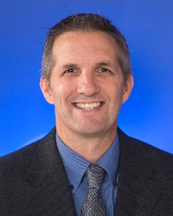
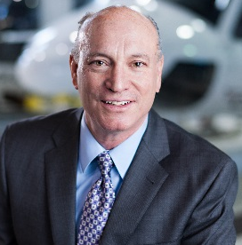
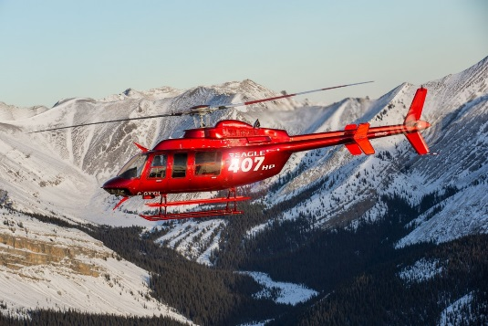
Vertical Flight Society
October 2018 Dinner Meeting
Date:
Thursday, October 25, 2018
Program:
5:00 – 6:00 PM Professional Networking &
Appetizers (cash bar)
6:00 – 7:00 PM Dinner
7:00 – 8:00 PM Presentation
Location:
Found RE Hotel
The Gallery Room
1100 N. Central Avenue
Phoenix, AZ 85003
(I-10 and 1st Avenue)
Dinner :
Green Salad
Chicken in Chardonnay & Mushroom broth
Roasted Potatoes with Garlic & Rosemary
Seasonal Vegetable Sauté
Fresh Berry Parfait
GUEST SPEAKERS:
Honeywell & Eagle Copters
Rob Richardson
Business Manager
Honeywell Aerospace
Barry Kohler
President & CEO Eagle Copters Ltd.
HTS900 Retrofit for Eagle 407HP
Cost:
$35 Pre-Pay (before October 20th)
$40 after Oct 20th or at Door $15 Students/Teachers
$5 Valet Parking Available
Payment via PayPal or credit card at
http://vfsaz.org/activities/
or bring cash/checks to the door No refunds
Please RSVP by Oct 20th to RSVP@vfsaz.org
*VFS Federal ID: #131953506, Non-Profit 501 (C) (6)
VFS Membership not required to attend!
Notes:
1

